Slide 1
JavaScript part 1
Barb Ericson
Georgia Institute of Technology
May 2006

Slide 2
Learning Goals
Computing Concepts
  Recognize computing concepts in another programming language
    Variables, conditionals, iteration, functions
  Learn a bit about user interface elements
    Buttons, text fields, text areas, radio buttons, dialog boxes
  Learn a bit about handling user events
    onClick, onMouseOver, onMouseOut, onMouseMove

Slide 3
JavaScript isn't Java
JavaScript is a different language than Java
  JavaScript looks much like Java, but there are differences
JavaScript is a programming language that is embedded in Web pages
  Allows you to control HTML and parts of a web page
JavaScript is a scripting language
  Often executed by an interpreter in your browser
    Client-side JavaScript (most common type)
  Can be executed by the server
    Server-side JavaScript

Slide 4
JavaScript Syntax
Syntax is how a programming language looks
  How do you end a statement or expression?
    Java statements end with a semicolon
  How do you declare a variable?
  How do you specify a conditional?
  How do you specify a loop?
  How do you specify a block?
    In Java using { and }
  How do you declare a function (method that returns something)?

Slide 5
JavaScript Syntax
End of Statement
  Using a semicolon is recommended, but not required
Declaring a variable
  Just use the keyword var and then the name
    var count = 0;
  Don't specify the type like you do in Java
Conditionals
  Use if, else if, and else just like in Java
Loops
  Use for (init; test; change) or while(test) like Java
Blocks
  Use {} just like in Java

Slide 6
Declaring a Function in JavaScript
Use the keyword function followed by the name and a parameter list in ()
    function test()
    {
    document.writeln("This is a test");
    }
Use {} to define a block of statements
Use document.writeln and document.write
  instead of System.println and System.print
    This writes to the HTML page instead of to a console window
Notes:
Println and writeln write out the line and end it with the new line character(s).

Slide 7
Placing JavaScript in HTML Pages
Use <script> and </script> to embed JavaScript in HTML pages
  Put function definitions inside the header
    Between <head> and </head>
  Put calls to functions inside the body of the HTML page
    Between <body> and </body>

Slide 8
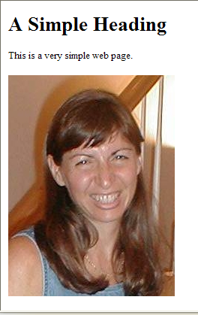
Our Simple Web Page
<!DOCTYPE HTML PUBLIC "-//W3C//DTD HTML 4.01 Transition//EN" "http://wwww.w3.org/TR/html4/loose.dtd">
<html>
<head>
<title>The Simplest Possible Web Page</title>
</head>
<body>
<h1>A Simple Heading</h1>
<p>This is a very simple web page.</p>
<p><image src="mediasources/barbara.jpg" />
</body>
</html>

Slide 9
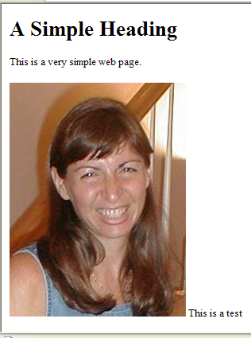
Adding some Simple JavaScript
<!DOCTYPE HTML PUBLIC "-//W3C//DTD HTML 4.01 Transition//EN" "http://wwww.w3.org/TR/html4/loose.dtd">
<html>
<head>
<title>The Simplest Possible Web Page</title>
<script>
function test()
{
document.writeln("This is a test");
}
</script>
</head>
<body>
<h1>A Simple Heading</h1>
<p>This is a very simple web page.</p>
<p><image src="mediasources/barbara.jpg" />
<script> test() </script></p>
</body>
</html>

Slide 10
How Does that Work?
<script>
function test()
{
document.writeln("This is a test");
}
</script>
</head>
<body>
<h1>A Simple Heading</h1>
<p>This is a very simple web page.</p>
<p><image src="mediasources/barbara.jpg" />
<script> test() </script></p>
Here’s a function named “test” with no inputs, that only writes out a string to the HTML page at the place it is called.
Here we execute the function.

Slide 11
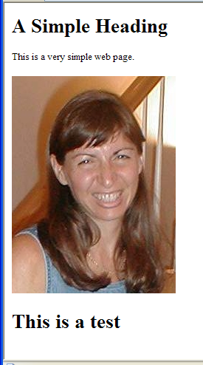
You can also Insert HTML
<script>
function insertHead()
{
document.writeln("<h1>This is a test</h1>");
}
</script>
</head>
<body>
<h1>A Simple Heading</h1>
<p>This is a very simple web page.</p>
<p><image src="mediasources/barbara.jpg" />
</p>
<script> insertHead() </script>
</body>
</html>

Slide 12
Can we Display Anything Useful?
Sure!
  Anything you can compute.
  Anything that you can get from built-in functions (mostly methods).
    There are lots of them.
You don’t have to have a function either in the header
  You can just put the JavaScript code in-line

Slide 13
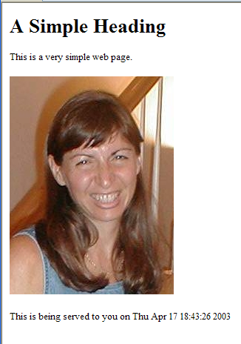
Displaying the date and time
<p>This is a very simple web page.</p>
<p><image src="mediasources/barbara.jpg" />
</p>
<p>This is being served to you on <script>document.write(Date());
</script></p>

Slide 14
Exercise
Date is an object
  That has a method for giving the hours
    var d = new Date();
    var time = d.getHours();
Modify the web page to give one of three different message depending on the time
  Like "Good Morning" if it is before 12, "Good Afternoon" if it is before 17 (5:00pm) and "Good Evening" if it is after 17

Slide 15
Summary
JavaScript is a scripting (interpreted) language for use in HTML pages
  Declare variables using
    var count = 0;
  Define functions using
    function name() {}
  Write text and HTML to the Web page using
    document.write or document.writeln
  There are built-in objects you can use
    document, date

